Slide 1
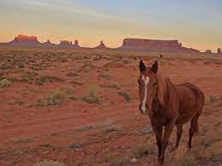
A Tool With No Name
Robert Reitmeier
Notes:
+

Slide 2
Contents
Recap: The Challenge

Slide 3
Bulletpoints
The Efficieny of Lazyness (search space reduction)
Branch, MC/DC, or Path Coverage (Statement follows from Branch)
Only Toplevel function coverage or full depth
Interface: Input C-Source (maybe already preprocessed), Output customizable (currently solutions.txt with ForeC )
Cutoffs (from Chess Programming)
Hourglass optimization?
Theoretical Work: Show Confluence of Trace Transformations, Normalization
Result Verification by Execution
Manual Search Optimization (solver_*functions)
Model level debugging (solver_debug)
Properties of the Prototype
3000 LoC, all in one file (refactoring!), extensive logging
Loop Length Inference
Pointer Casting requires going down to memory bit level
New(?) Method for MC/DC table generation
Surprising Facts (Loop breaking e.g.)
Show Tests
Compilation of Source Code Snippets
State Of the Art?
Performance in Project qkitknorrbremse
Examples
Potential (other than Coverage Completion)
Automatic Compiler Qualification Test Suite Creation
Rendering CTC superfluous (“How to make enemies”?)
Outstripping VectorCAST (“How to make enemies”?)
Discover Semantic Error Patterns (Dead code e.g.)
C++ Parser needed -> all for C++

Slide 4
The Challenge
Library Qualification: ISO26262 demands 100% MC/DC Source Code Coverage for ASIL D !
Given: C Source Code of a Library function
Needed: All function arguments (=“test vectors”) so that we reach 100 % MC/DC coverage when running the tests

Slide 5
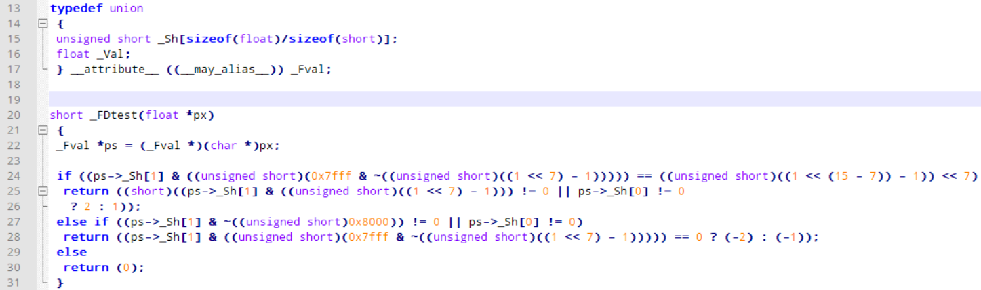
Challenge Example _FDtest
---- Trace [1,1] -----------------------------------
_FDtest ( px = <SOME_PTR> , PTR_px = NaN(0x00ffff) = 0xff80ffff = NaN ) = return_val = 2
Covered branches:
Then branch 1 "if((ps->_Sh[1] & (unsigned short) (0x7fff & ..." at line 24, col 7, len 124
Then branch 1 "(F||T)" at line 25, col 20, len 70

Slide 6
Challenge 4 U
How many test vectors needed for 100% MC/DC coverage?
if (line 24)
then
else
3
else if (line 27)
T || _
F || F
2
F || T
1
1
2

Slide 7
Challenge Solution _FDtest
---- Trace [1,1] -----------------------------------
_FDtest ( px = <SOME_PTR> , PTR_px = NaN(0x00ffff) = 0xff80ffff = NaN ) = return_val = 2
Covered branches:
Then branch 1 "if((ps->_Sh[1] & (unsigned short) (0x7fff & ..." at line 24, col 7, len 124
Then branch 1 "(F||T)" at line 25, col 20, len 70
---- Trace [1,2] -----------------------------------
_FDtest ( px = <SOME_PTR> , PTR_px = -Infinity = 0xff800000 = -Infinity ) = return_val = 1
Covered branches:
Then branch 1 "if((ps->_Sh[1] & (unsigned short) (0x7fff & ..." at line 24, col 7, len 124
Else branch 2 "(F||F)" at line 25, col 20, len 70
---- Trace [1,3] -----------------------------------
_FDtest ( px = <SOME_PTR> , PTR_px = NaN(0x7f0000) = 0xffff0000 = NaN ) = return_val = 2
Covered branches:
Then branch 1 "if((ps->_Sh[1] & (unsigned short) (0x7fff & ..." at line 24, col 7, len 124
Then branch 3 "(T||F)" at line 25, col 20, len 70
---- Trace [2,1,1] -----------------------------------
_FDtest ( px = <SOME_PTR> , PTR_px = 0x1p-149 = 0x00000001 = 1.0e-45 ) = return_val = -2
Covered branches:
Else branch 2 "if((ps->_Sh[1] & (unsigned short) (0x7fff & ..." at line 24, col 7, len 124
Then branch 1 "(F||T)" at line 27, col 12, len 63
Then branch 1 "(ps->_Sh[1] & (unsigned short) (0x7fff & ..." at line 28, col 12, len 81
---- Trace [2,2] -----------------------------------
_FDtest ( px = <SOME_PTR> , PTR_px = 0x0p+0 = 0x00000000 = 0.0 ) = return_val = 0
Covered branches:
Else branch 2 "if((ps->_Sh[1] & (unsigned short) (0x7fff & ..." at line 24, col 7, len 124
Else branch 2 "(F||F)" at line 27, col 12, len 63
---- Trace [2,3,1] -----------------------------------
_FDtest ( px = <SOME_PTR> , PTR_px = -0x1.fcp-127 = 0x807f0000 = -1.1663108e-38 ) = return_val = -2
Covered branches:
Else branch 2 "if((ps->_Sh[1] & (unsigned short) (0x7fff & ..." at line 24, col 7, len 124
Then branch 3 "(T||F)" at line 27, col 12, len 63
Then branch 1 "(ps->_Sh[1] & (unsigned short) (0x7fff & ..." at line 28, col 12, len 81
---- Trace [2,3,2] -----------------------------------
_FDtest ( px = <SOME_PTR> , PTR_px = -0x1.fep127 = 0xff7f0000 = -3.3895314e38 ) = return_val = -1
Covered branches:
Else branch 2 "if((ps->_Sh[1] & (unsigned short) (0x7fff & ..." at line 24, col 7, len 124
Then branch 3 "(T||F)" at line 27, col 12, len 63
Else branch 2 "(ps->_Sh[1] & (unsigned short) (0x7fff & ..." at line 28, col 12, len 81

Slide 8
How Did It Do That?
For all possible paths through the code:
Garble up all decision conditions on each path (if, switch, conditional expressions, loop conditions)
Assume them true of false (depending on the branch to take)
Translate the assumptions to theorem prover language
Have the theorem prover solve the formula
Remember solution models (if any)
f(x,y)
True
if A then
(A(x,y))
else
(¬A)
if B||C then
(B)
if B||C then
(¬B ∧ C)
else
(¬B ∧ ¬C)
return 1;
A ∧ B
return 2;
A ∧ (¬B ∧ C)
return 3;
¬A ∧ (¬B ∧ ¬C)
return 4;
¬A

Slide 9
Definiton of “Trace”
Trace [1,3]
f(x,y)
True
1
2
if A then
(A(x,y))
else
(¬A)
1
2
3
if B||C then
(B)
if B||C then
(¬B ∧ C)
else
(¬B ∧ ¬C)
return 1;
A ∧ B
return 2;
A ∧ (¬B ∧ C)
return 3;
¬A ∧ (¬B ∧ ¬C)
return 4;
¬A

Slide 10
Z3 Formula for _FDtest [1,1]
if((ps->_Sh[1] & (unsigned short) (0x7fff & ~(unsigned short) ((1 << 7) - 1))) == (unsigned short) ((1 << 15 - 7) - 1) << 7)
; ----------------------------------------------
; COND Then branch 1 "if((ps->_Sh[1] & …
; ----------------------------------------------
(assert
(=
((_ zero_extend 16)
(bvand
(select
arr$$5
#x00000001
)
((_ extract 15 0)
(bvand
#x00007fff
((_ zero_extend 16)
(bvnot
((_ extract 15 0)
(bvsub
(bvshl
#x00000001
#x00000007
)
#x00000001
)
)
)
)
)
)
(bvshl
((_ zero_extend 16)
((_ extract 15 0)
(bvsub
(bvshl
#x00000001
(bvsub
#x0000000f
#x00000007
)
)
#x00000001
)
)
)
#x00000007
)

Slide 11
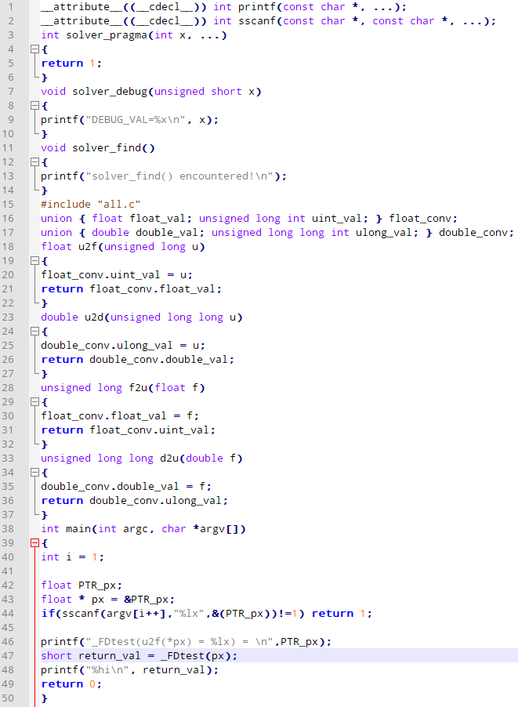
Trace Result Verification
Compile and execute the code: Result = Prediction?
Get arguments from commandline
Execute function Print return value to stdout

Slide 12
Template
Library Qualification: ISO26262 demands

Slide 13
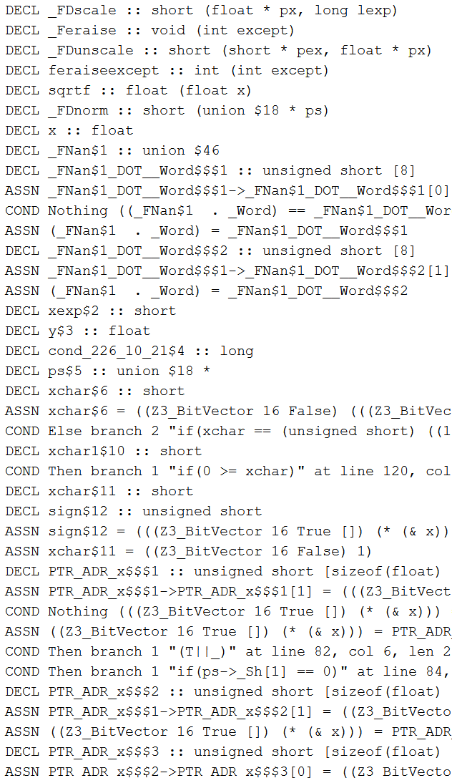





Cutoffs
Inspired by α-/β - Cutoffs from Chess Programming
Formula $φ$ monotonic in models when adding assertion $φ′$:
$$∄ M . M \text{⊧} φ \overset{⇒}{ } ∄ M . M \text{⊧} φ \text{∧} φ^{′}$$
$$φ$$
Towards RETURN
Cutoff if no solution for $φ !$
$$φ′$$

Slide 14
Strategic Design Principles
Make it as easy as possible for the theorem prover (for example: no ∀, ∃), because:
Z3 not under my control („black box“)
More semantic information available for the tool
Extensive Logging (Dynamic HTML)
Defensive Programming: Throw errors in all cases that were not explicitly implemented

Slide 15
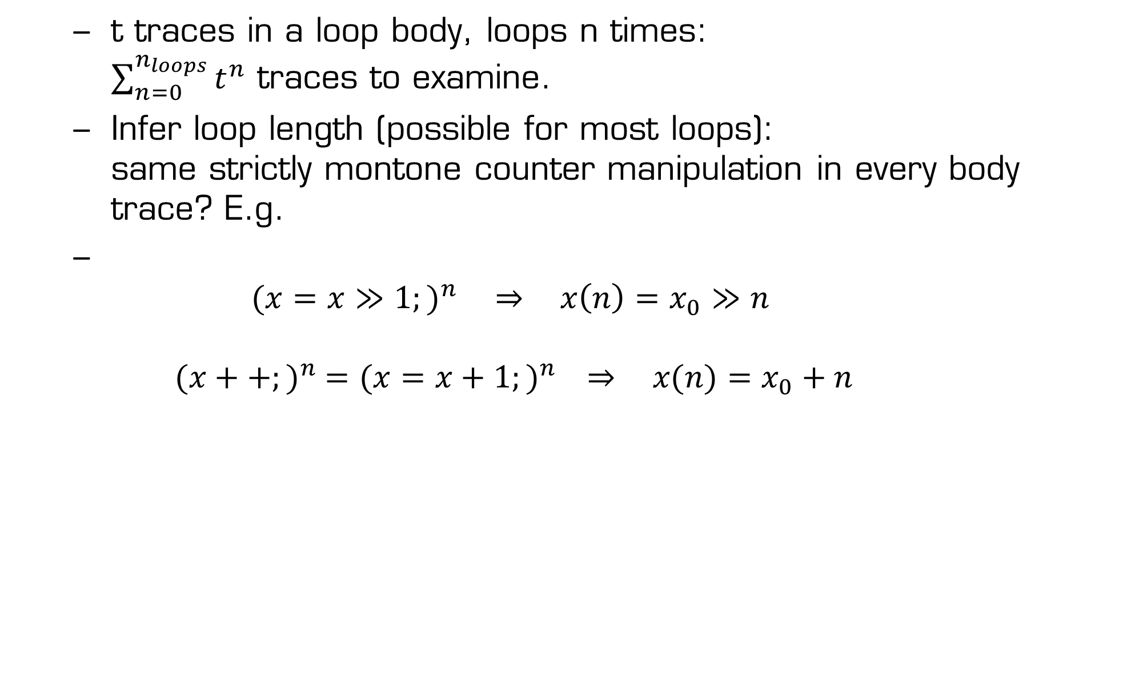
Loop Length Inference
t traces in a loop body, loops n times: $\sum_{n=0}^{n_{loops}}{t^{n}}$ traces to examine.
Infer loop length (possible for most loops): same strictly montone counter manipulation in every body trace? E.g.
${(x=x≫1;)}^{n} \underset{⇒}{ } x\left(n\right)=x_{0}≫n$ ${(x++;)}^{n} ={(x=x+1;)}^{n} \underset{⇒}{ } x(n)=x_{0}+n$
n ⩾ _0, not_ cond_0 ⋏ n ⩵ _0 ⋎ cond_nminus1 ⋏ n ⩾ _1 ⋏ not_ cond_n

Slide 16
Future Work
Incremental Solving (pushing assertions, goes will with cutoff)
Refactor for Side Effects in Expressions
Semantic Simplifications?!
Hourglass Optimization
Logical isolation of functions
Better understanding of inner workings of Z3
Completing Code Snippets automatically
C++ (when C++ Parser is available)

Slide 17


